Slide 1










Women Safety Project Guardian Wave
A legal awareness app that integrates self-defense training and AI – driven counselling

Slide 2
Team Details Details
Team Leader
Mr. Sriram S
Team Members
Ananya Bottu
Bhamini V
M Maghasri
Sheethal Raj

Slide 3
Pipelines
01
02
03
04
Safety Measures
Trauma Support
Suggests safety measures to the user.
Gives emotional support to the victim.
Legal
Advice
Self-Defence Tutorials
Provides legal information to the victim.
Suggests videos on self-defense.

Slide 4



Pipeline 1 Safety measures Sample input/output:

Slide 5
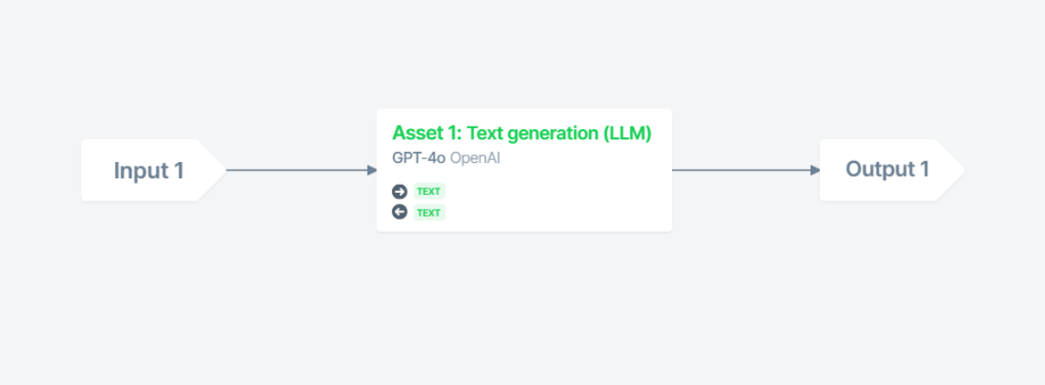
PIPELINE REVIEW

Slide 6
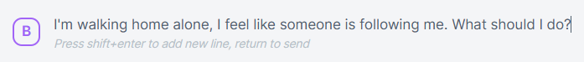
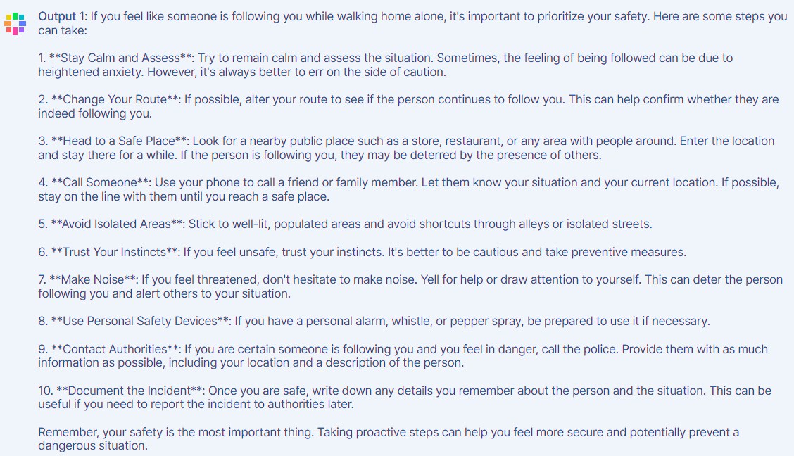

Slide 7



Pipeline 2 Trauma Support
Sample input/output:

Slide 8
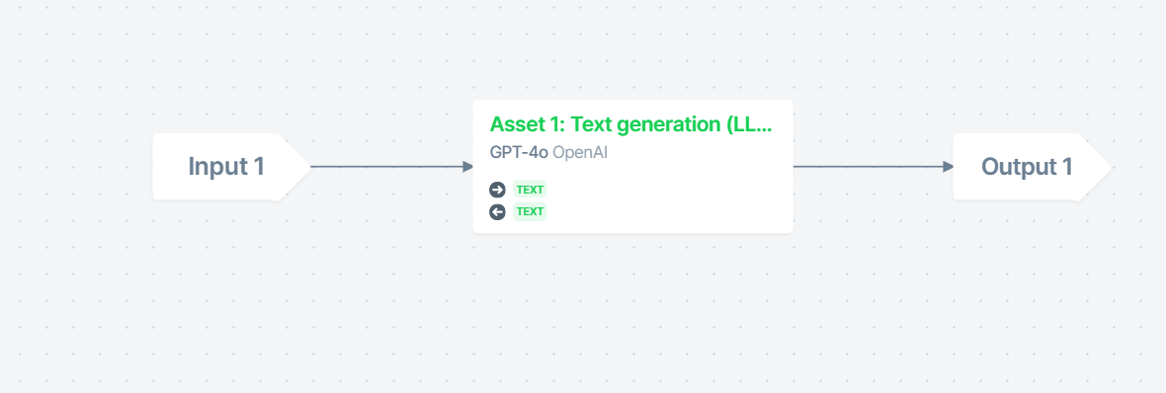
PIPELINE REVIEW

Slide 9
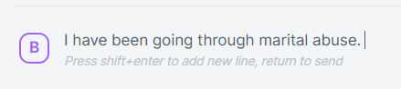
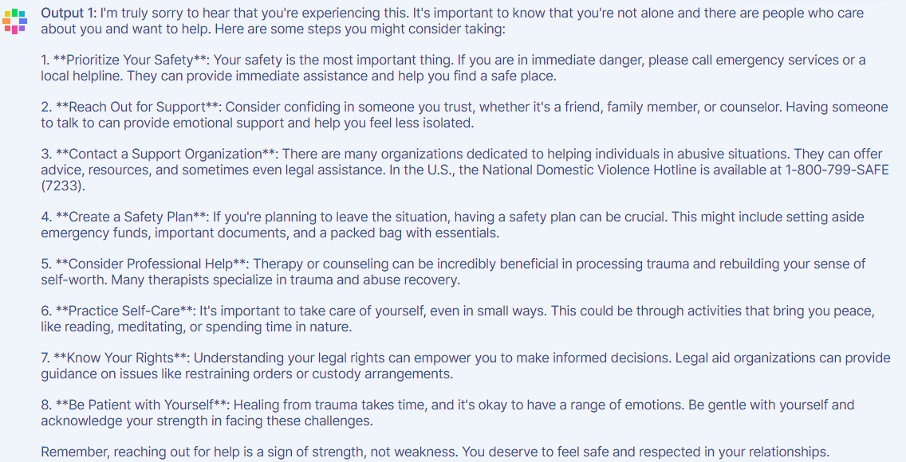

Slide 10
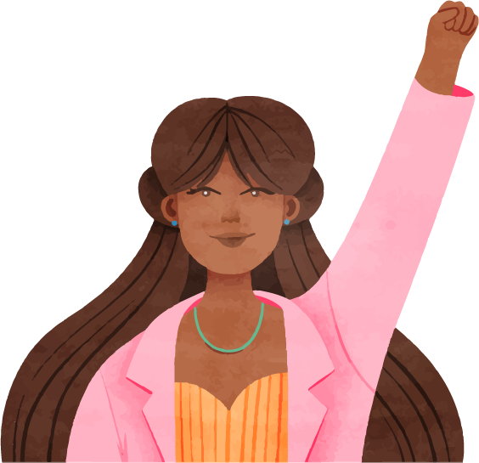


Pipeline 3 Legal Advice Sample input/output:

Slide 11
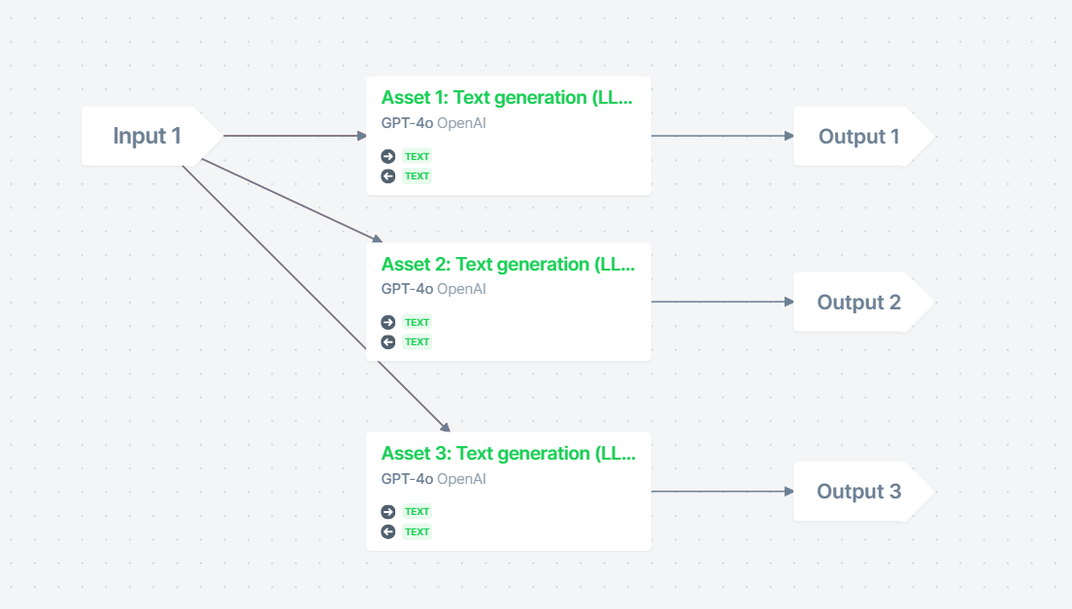
PIPELINE REVIEW

Slide 12

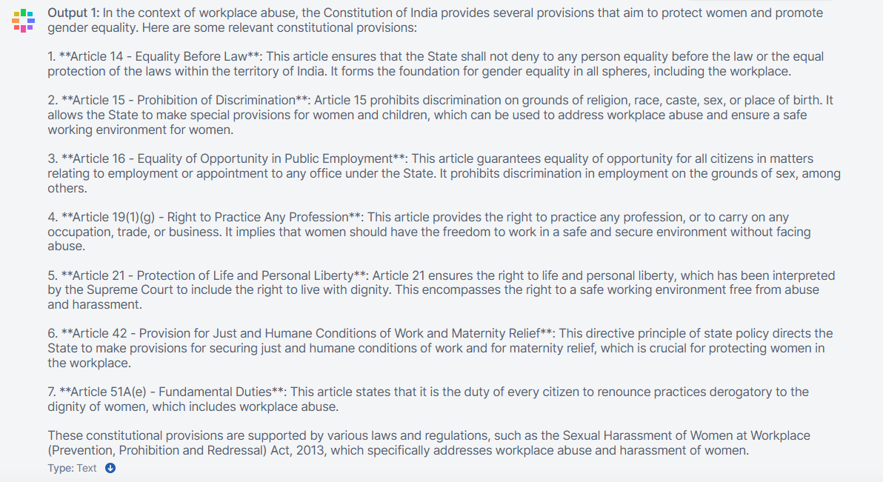

Slide 13
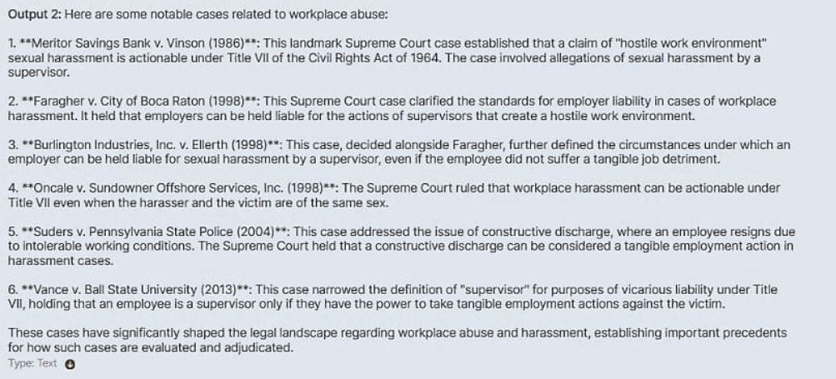

Slide 14
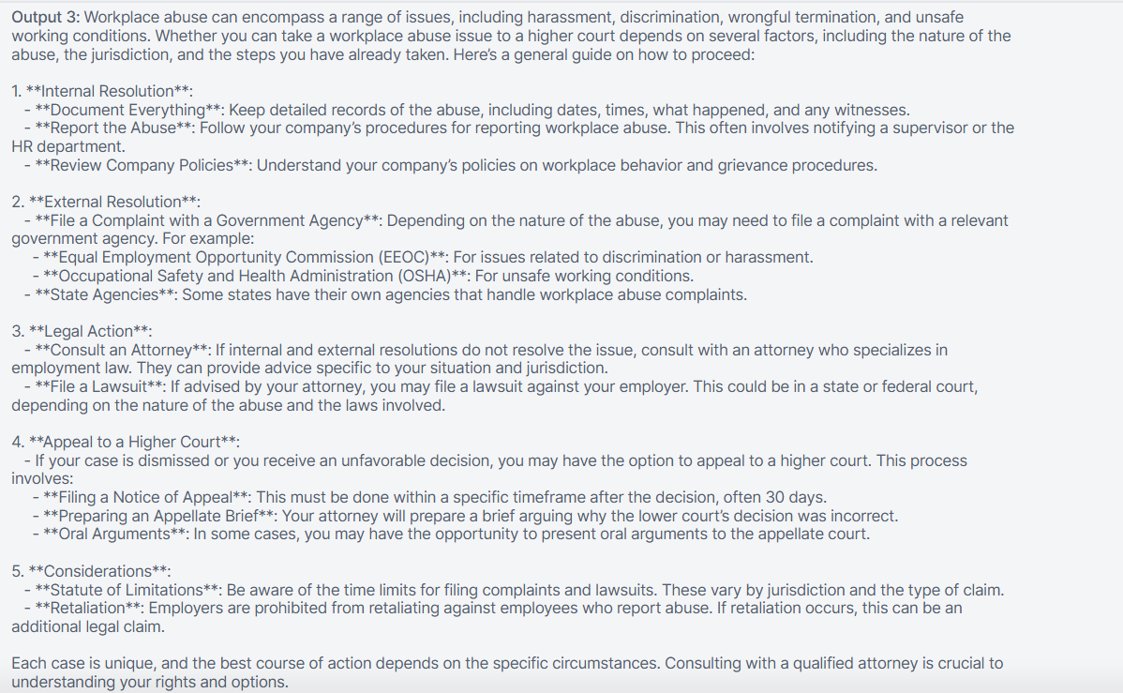

Slide 15



Pipeline 4 Self-Defence Tutorials Sample input/output:

Slide 16
PIPELINE REVIEW

Slide 17
Thank You

